Slide 1

Retrieval-Augmented Generation (RAG) & AI Ethics

Slide 2
Session Overview
What is RAG?
How RAG Works
RAG Demo & Tools
Wrap-Up Discussion

Slide 3
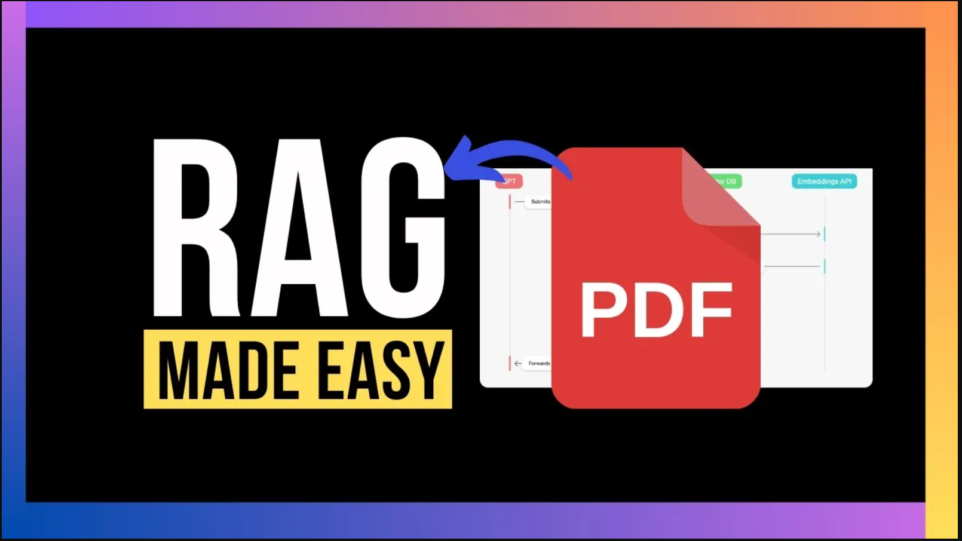
Why RAG?
LLMs can't access external data.
They may hallucinate or provide outdated responses.
RAG enables fact-based, accurate responses.

Slide 4
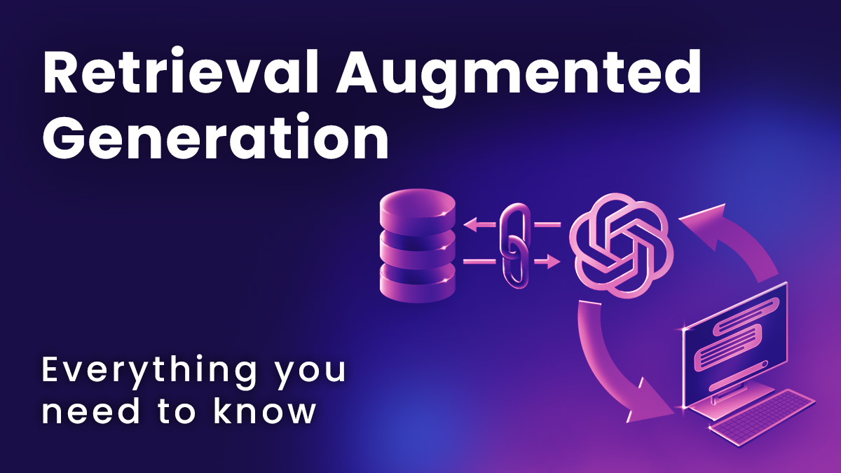
What is RAG?
RAG = Retrieval-Augmented Generation
It fetches info from external sources before LLM answers.
Makes responses context-aware and reliable.

Slide 5
RAG Architecture
(Simple View)
User enters a query.
Retriever fetches relevant text.
Generator (LLM) uses that to create a response.

Slide 6
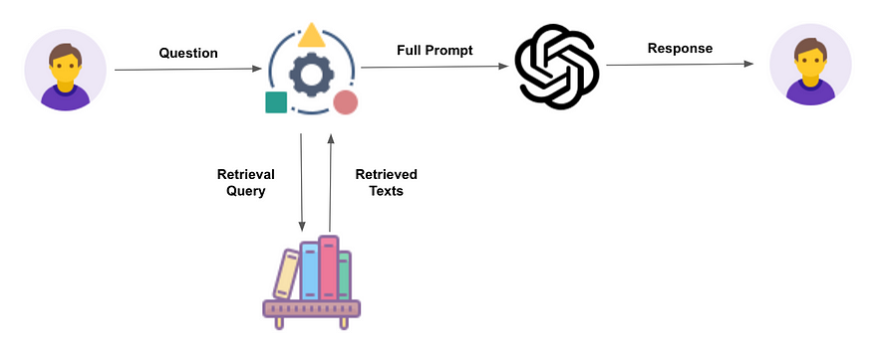
RAG Architecture

Slide 7
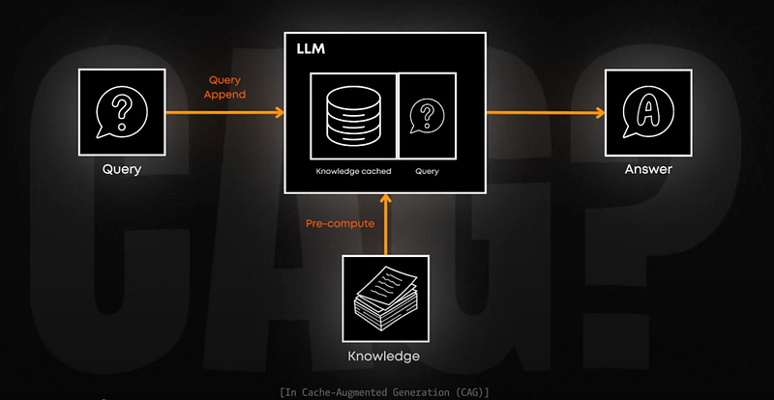
Example Scenario
Question: "What’s the return policy?“
Without RAG: General guess.
With RAG: Accurate policy fetched from company PDF.

Slide 8
Components of RAG
Chunking: Break document into small parts
Embedding: Convert text to vectors
Store: Use vector DB (ChromaDB)
Retrieve: Find relevant chunks
Generate: Answer using LLM

Slide 9
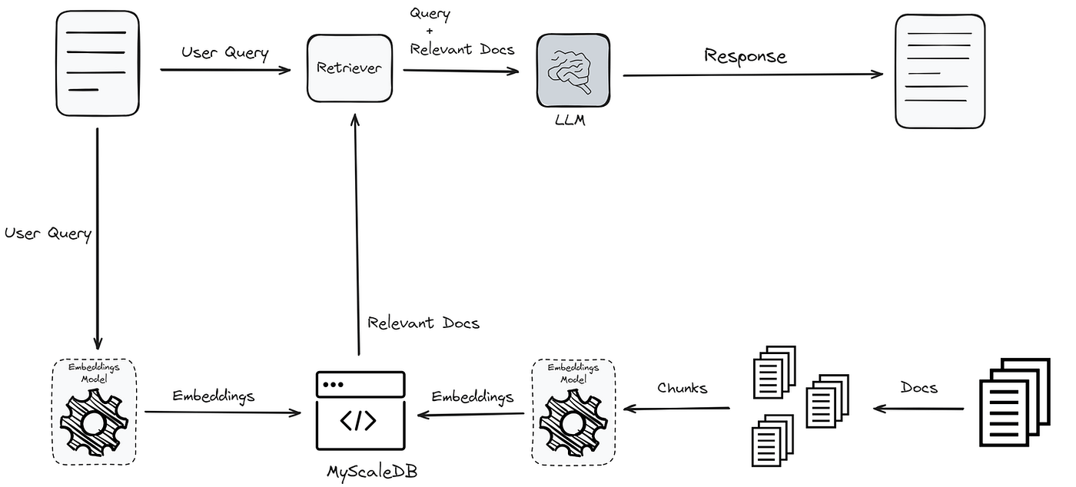

Slide 10
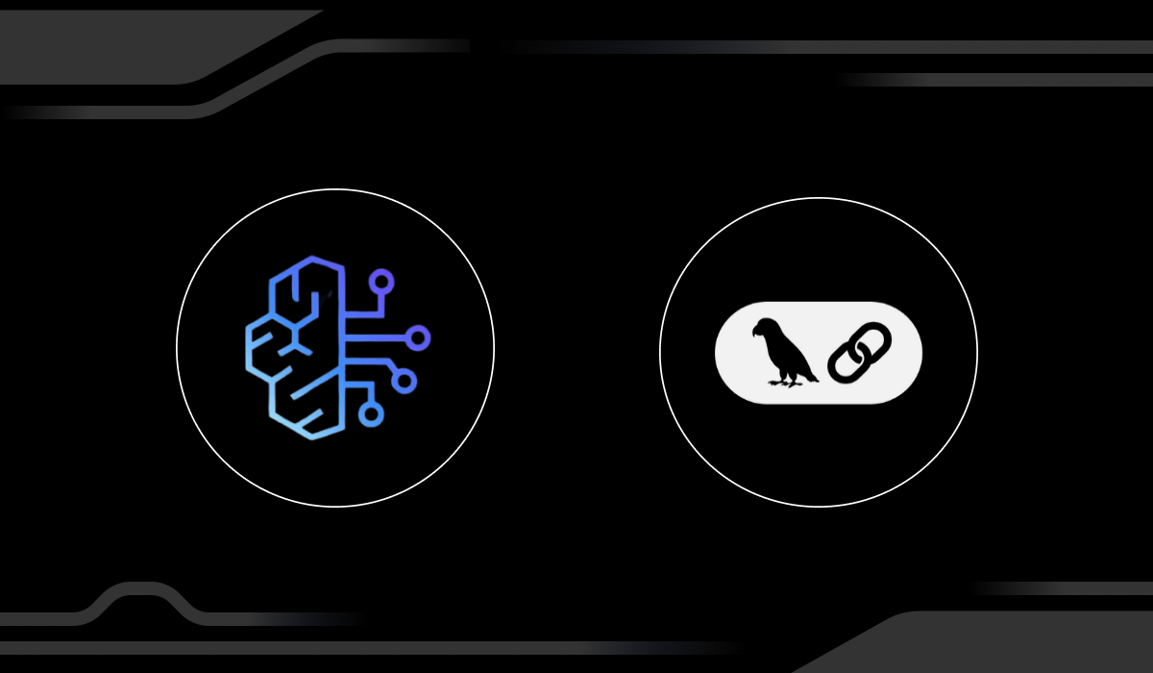
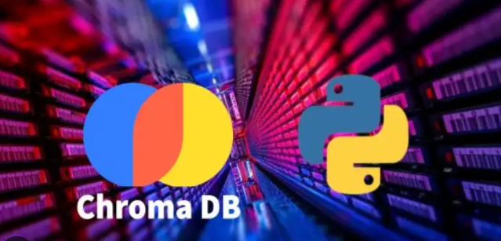
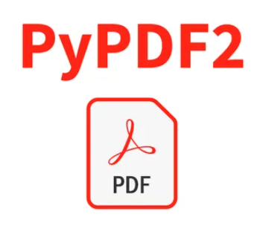
Tools for RAG Implementation
LangChain – Orchestrates the process
ChromaDB – Stores vectors
SentenceTransformers – Embedding model
PyPDF – PDF loader

Slide 11
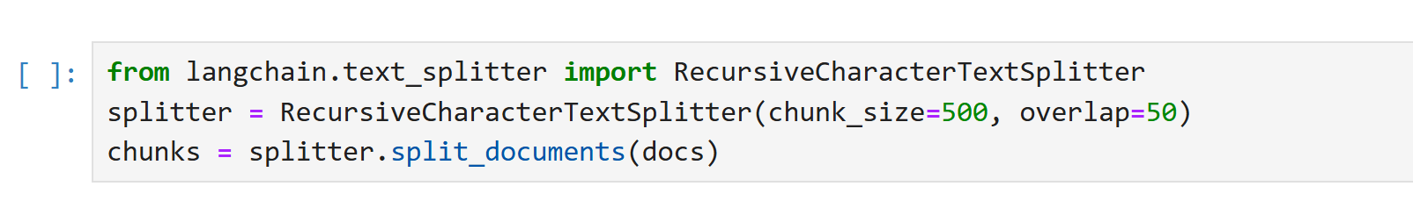
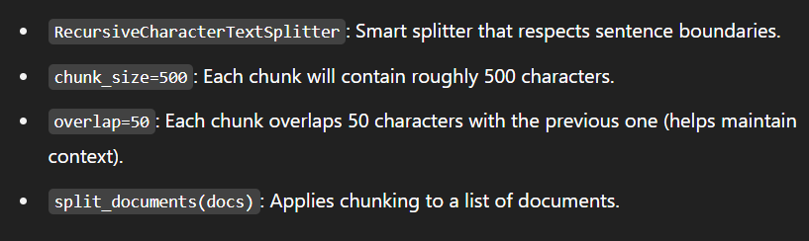
Step 1 – Chunking
“Chunking” refers to the process of splitting large documents or text into smaller, manageable parts (chunks) before processing them with a language model or storing them in a vector database.

Slide 12
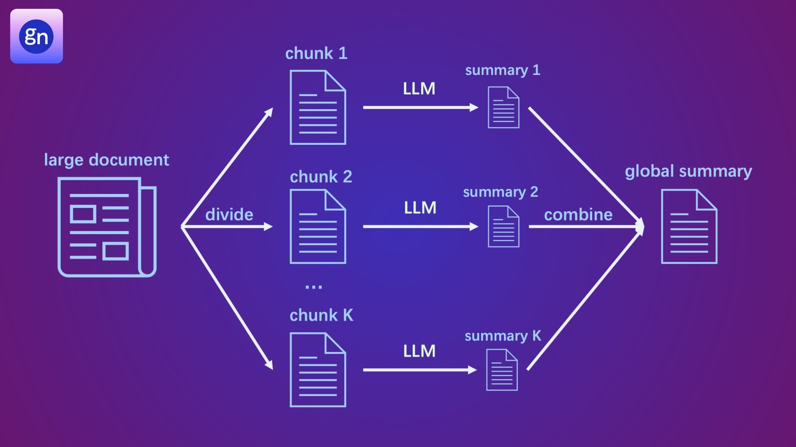
Chunking

Slide 13
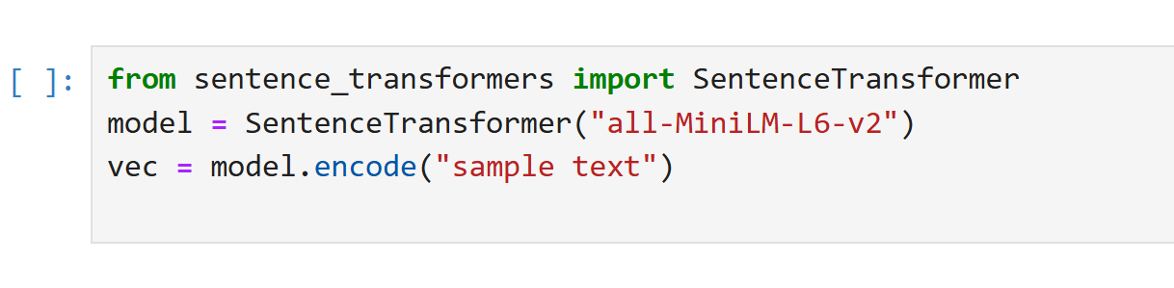
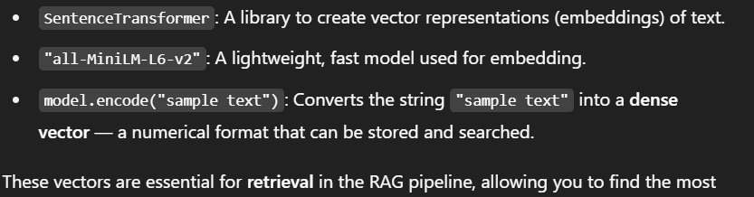
Step 2 – Embedding
"Embedding" in this context means converting text into numerical vectors using an AI model. These vectors help the system understand the semantic meaning of the text and allow similarity-based searching.

Slide 14
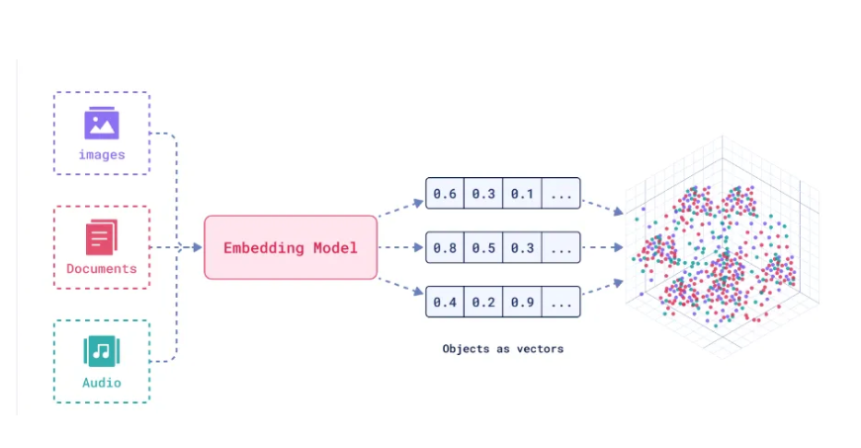
Embedding

Slide 15
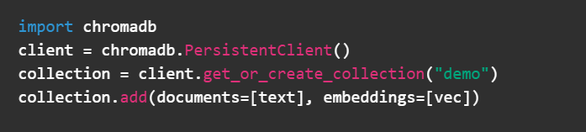
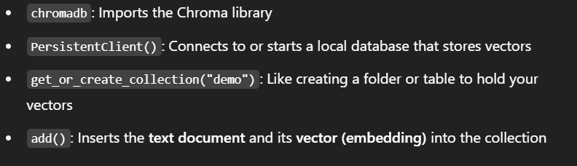
Step 3 – Store in ChromaDB
ChromaDB is a vector database — it stores embeddings (numerical vectors) of your documents so they can be searched efficiently using similarity (not exact keywords).
Why store in ChromaDB?
Once you embed your text chunks (i.e., convert them into vectors), you need a way to:
Save them
Search through them
Retrieve the most relevant ones later

Slide 16
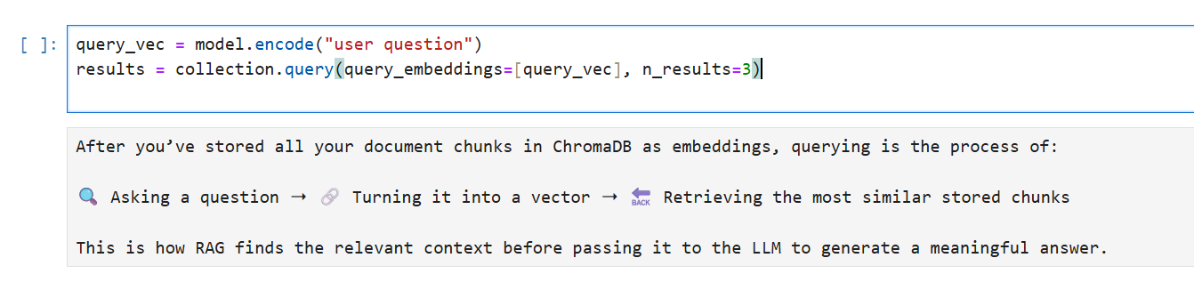
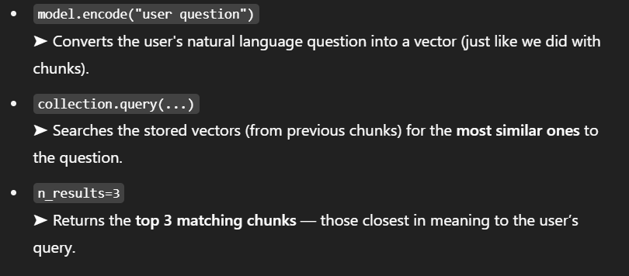
Step 4 – Querying
Why is this important?
You don’t pass the whole document to the LLM — only the top relevant chunks.
It improves speed, reduces hallucination, and gives accurate, contextual responses.

Slide 17
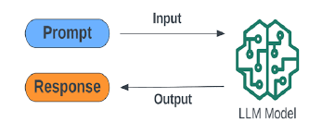
Query and Answer

Slide 18
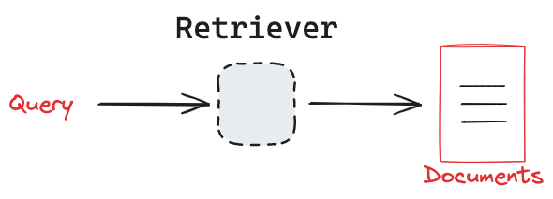
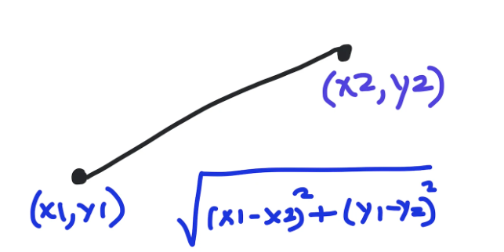
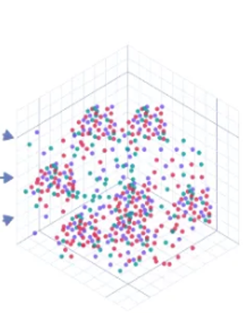
Euclidean Distance

Slide 19
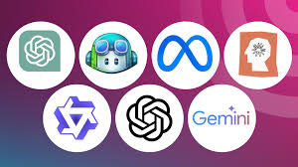
Step 5 – Generation
Feed the retrieved chunks into your LLM.
LLM uses these as context to generate the final answer.
Merges retrieval + natural language generation

Slide 20
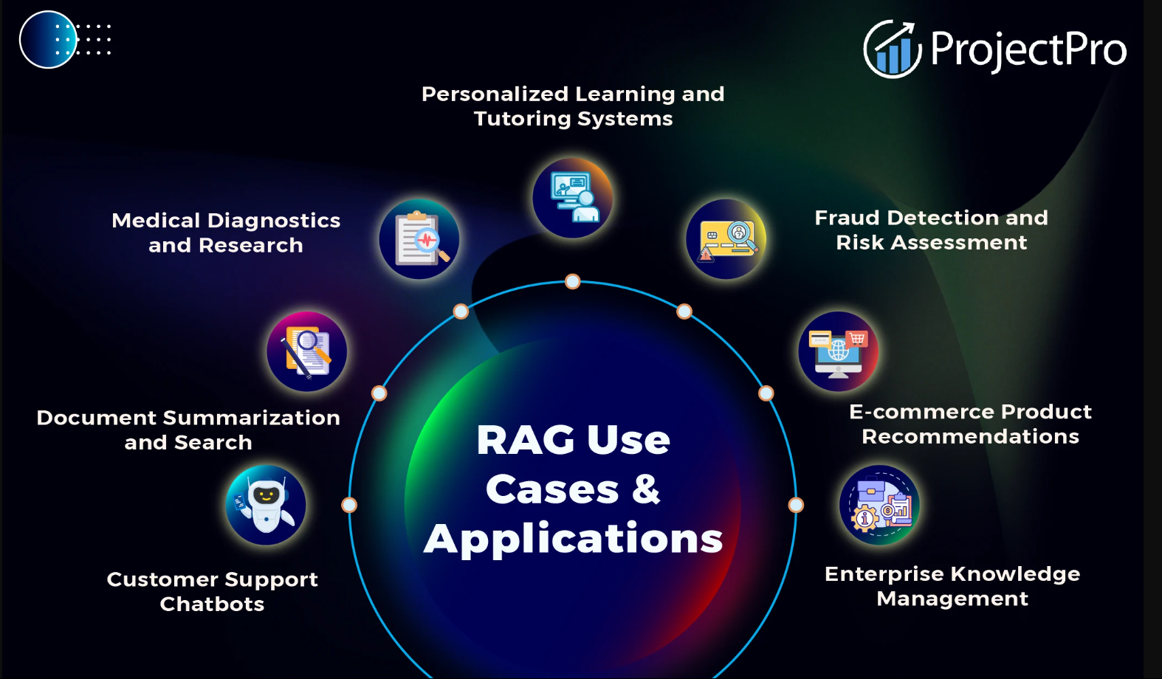
Flow of RAG
[Query → Chunk → Embed → Store → Retrieve → Generate]
Application of RAG

Slide 21

Let’s develop a RAG Project..?

Slide 22
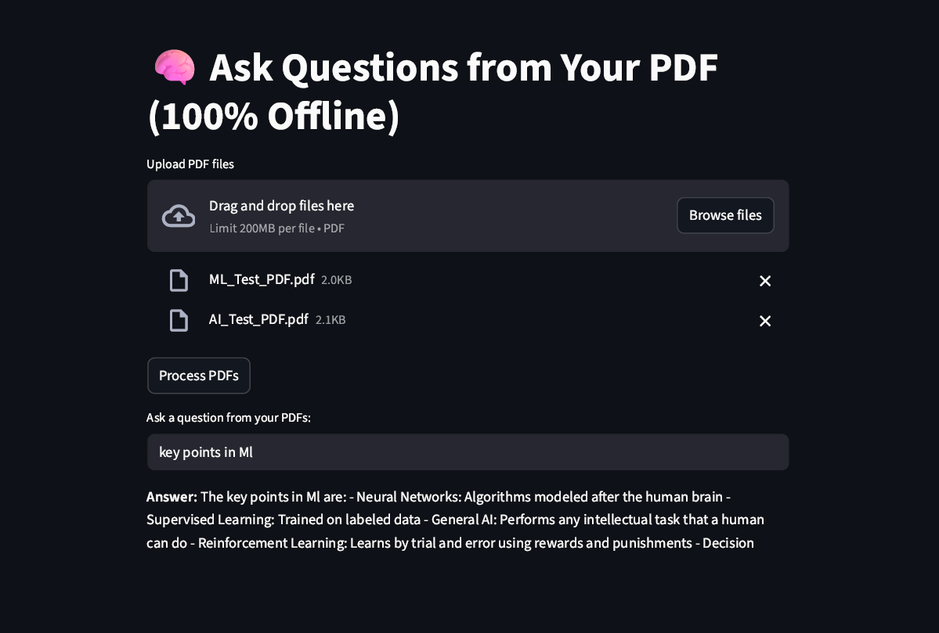
It’s going to be a very simple task
Explain RAG architecture
Mention use of open-source models (LaMini-T5, MiniLM)
Point out where models are plug-and-play
Offline Chat with PDF using LangChain & HuggingFace
Overview
This practical project allows users to chat with uploaded PDF files entirely offline using local models for both embeddings and language generation.
It uses:
LangChain for chaining retrieval and QA
Sentence Transformers for embedding
FAISS for vector storage and similarity search
Hugging Face transformers for text generation
Streamlit for web UI

Slide 23
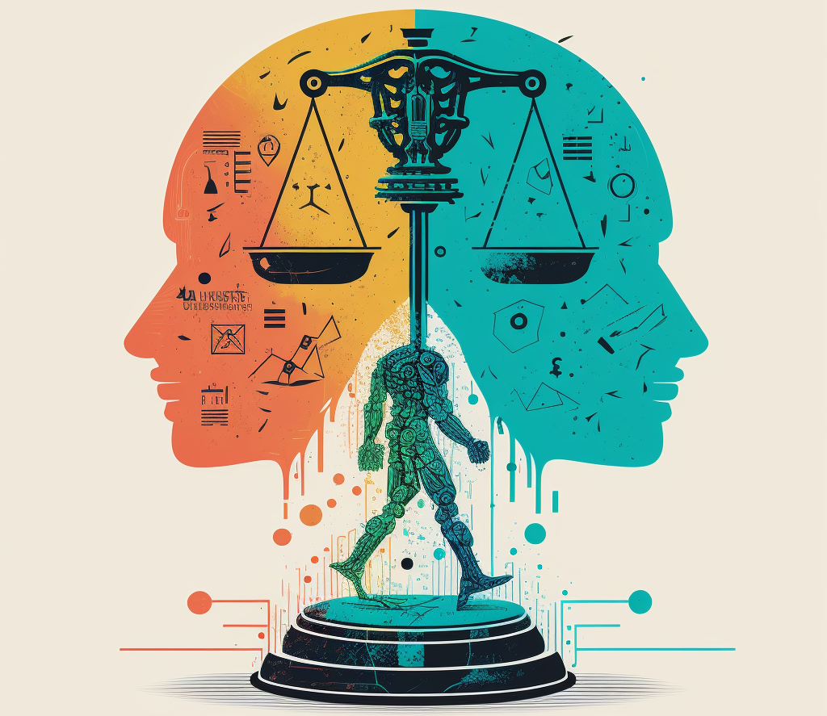
What is AI Ethics?
Ethics = moral guidelines for responsible AI use.
Covers fairness, safety, privacy, and sustainability.

Slide 24
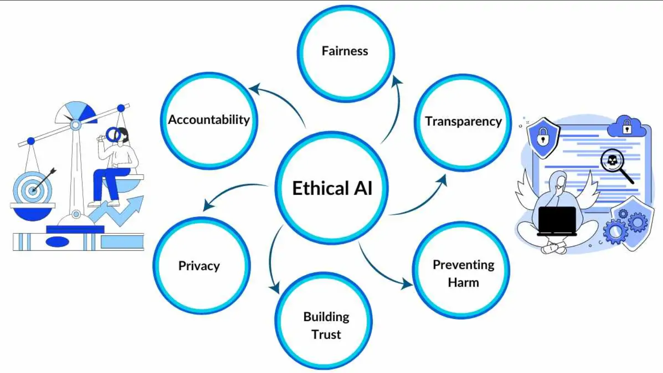
Why AI Ethics Matter
AI decisions impact real lives.
Biased or wrong outputs can cause harm.
Ethical design ensures safe deployment.

Slide 25
Bias in AI
AI learns from human data (may include bias)
Can affect hiring, lending, law enforcement
Mitigation: diverse training data & fairness checks

Slide 26
Misinformation / Hallucination
LLMs sometimes generate false or made-up facts
Very risky in healthcare, law, finance
Fix: Use RAG, human-in-the-loop review

Slide 27
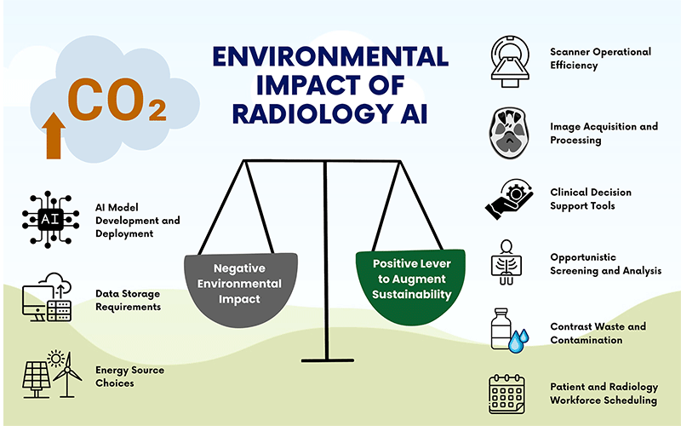
Environmental Impact
Training big models = high carbon emissions
GPT-3 ~ 552 tons CO₂
Use smaller/fine-tuned models like LoRA, QLoRA

Slide 28
Best Practices for Ethical AI
Clean, unbiased training data
Transparency in decisions
Monitor and retrain frequently

Slide 29
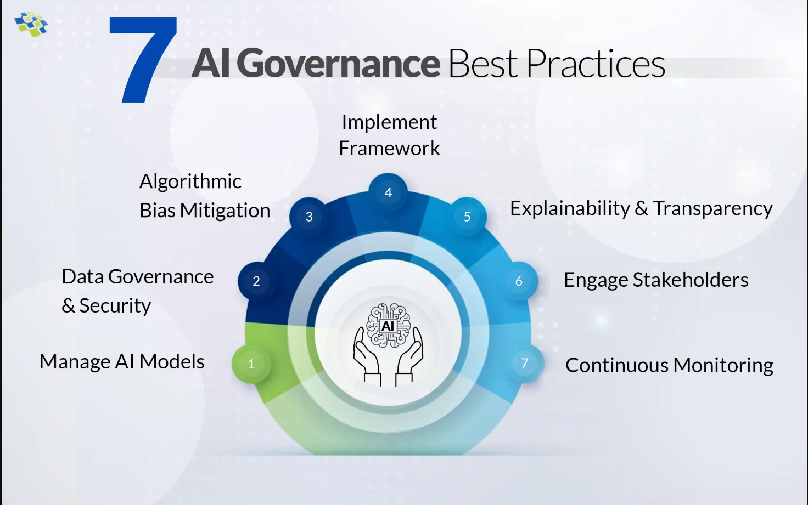
AI Governance & Responsibility
Companies should set ethical standards
Responsibility should be shared by developers and users

Slide 30

Discussion Prompts
Should AI be allowed in legal/medical decisions?
Can ethics restrict innovation?
Who is liable when AI fails?

Slide 31
Thank You

